Slide 1
Team Member(s): Amanda Chiu, Valeria Lopez Product Owner(s): Jaime Borras Instructor: Masoud Sadjadi School of Computing and Information Sciences Florida International University
Senior Project Final Presentation Fall 2015
LegalWise
<date of the presentation>
Notes:
Greet your audience, thank them for attending your presentation, introduce yourself, introduce your project, introduce your team members, and quickly indicate what each of you did in a high-level manner, and put more emphasis on your part/contribution.

Slide 2
Problem definition
Whole Project:
Legal professionals spend a lot of time and resources to access files and information for future cases.
My Part:
Set up a user interface with basic functional features for the application.
Notes:
Introduce the problem that the whole project tackles and stay focused on the parts that you have been working. Indicate if there is an existing previous system, enumerate its problems/limitations, etc.

Slide 3
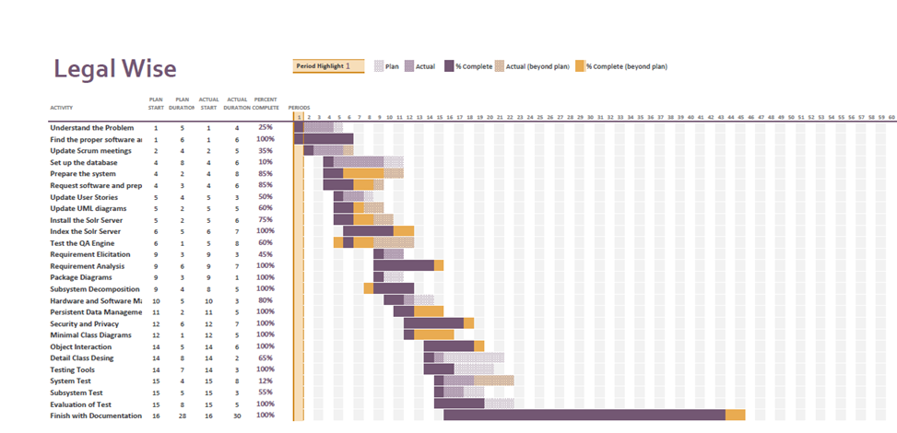
Project Management
Notes:
Project Management (schedule for entire semester) (one slide; Gantt Chart).

Slide 4
Requirements: User Stories
User stories that I worked on:
Log in
Verify user account
Create account
Notes:
4. Requirements:
4.1. User stories implemented (one or more slides).
4.2. UML use cases and the use case diagram for the implemented use cases (one or more slides).
4.3. UML sequence diagrams for the implemented use cases.

Slide 5
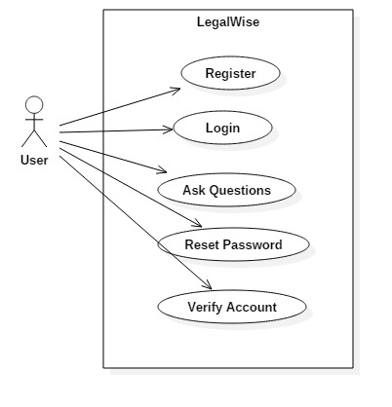
Use Case Diagram
Notes:
4. Requirements:
4.1. User stories implemented (one or more slides).
4.2. UML use cases and the use case diagram for the implemented use cases (one or more slides).
4.3. UML sequence diagrams for the implemented use cases.

Slide 6
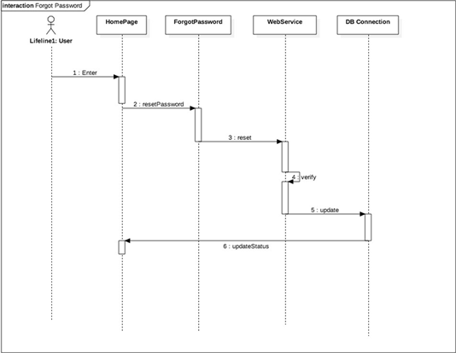
Sequence Diagram
Forget Password
Notes:
4. Requirements:
4.1. User stories implemented (one or more slides).
4.2. UML use cases and the use case diagram for the implemented use cases (one or more slides).
4.3. UML sequence diagrams for the implemented use cases.

Slide 7
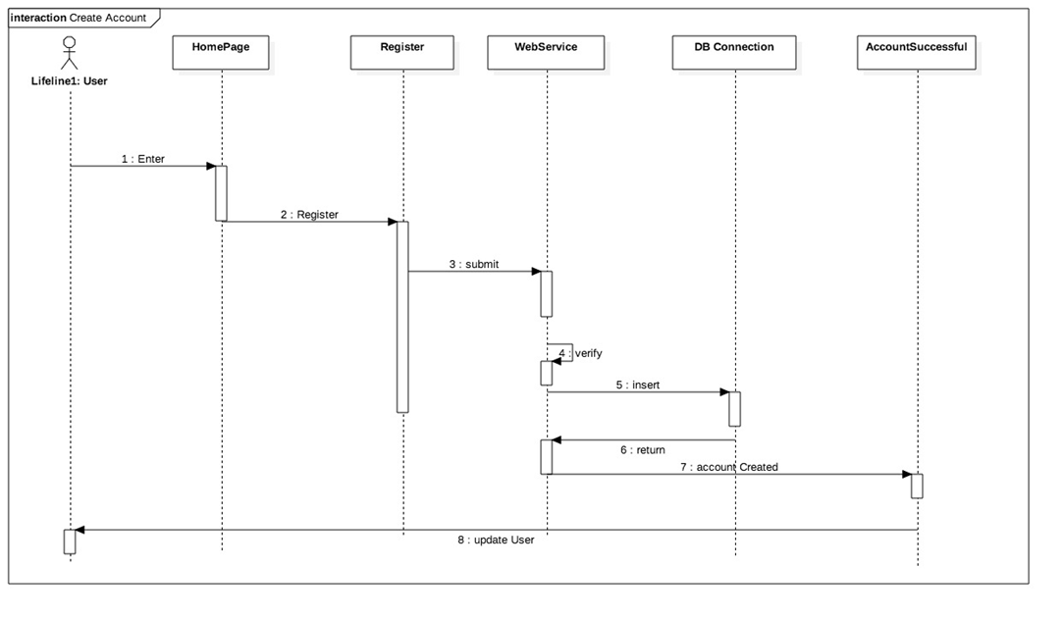
Sequence Diagram
Create Account

Slide 8
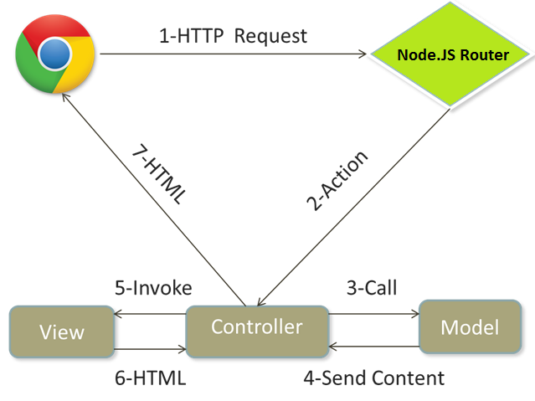
System Design: Architecture
MVC
Notes:
5. System design:
5.1. System decomposition; identify the architecture patterns used (one slide).
5.2. System deployment – h/w and s/w requirements (one slide).
5.3. Persistent data design (one slide).
5.4. Security/Privacy (one slide).

Slide 9
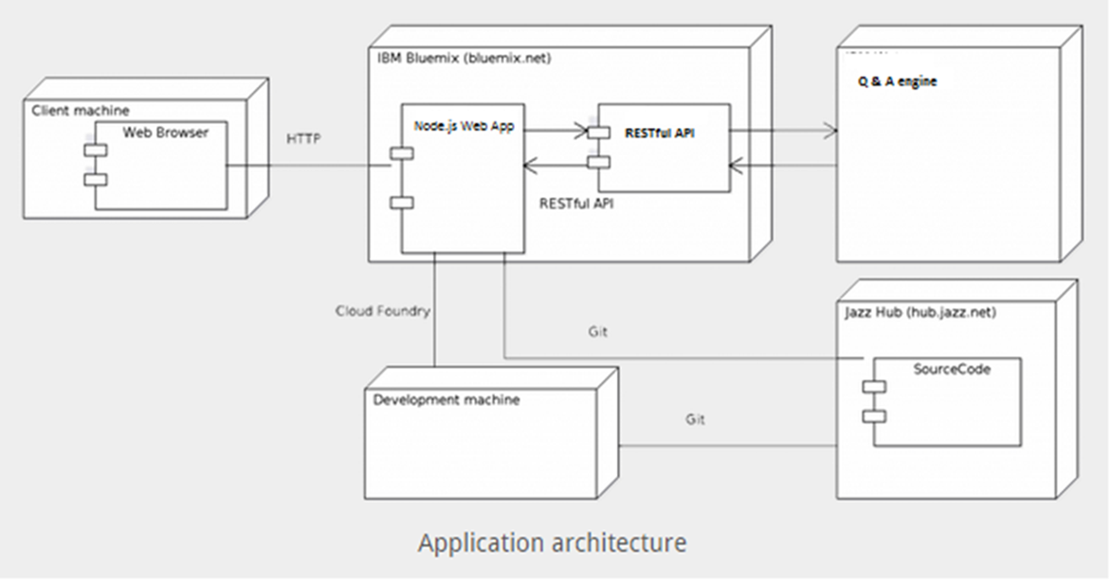
System Design: Deployment
Notes:
5. System design:
5.1. System decomposition; identify the architecture patterns used (one slide).
5.2. System deployment – h/w and s/w requirements (one slide).
5.3. Persistent data design (one slide).
5.4. Security/Privacy (one slide).

Slide 10
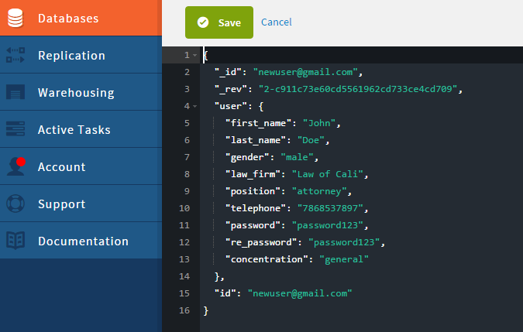
System Design
Cloudant NoSQL Database
Stored as JSON Objects
Security /Privacy
Only user’s basic information is stored in the database.
Notes:
5. System design:
5.1. System decomposition; identify the architecture patterns used (one slide).
5.2. System deployment – h/w and s/w requirements (one slide).
5.3. Persistent data design (one slide).
5.4. Security/Privacy (one slide).

Slide 11
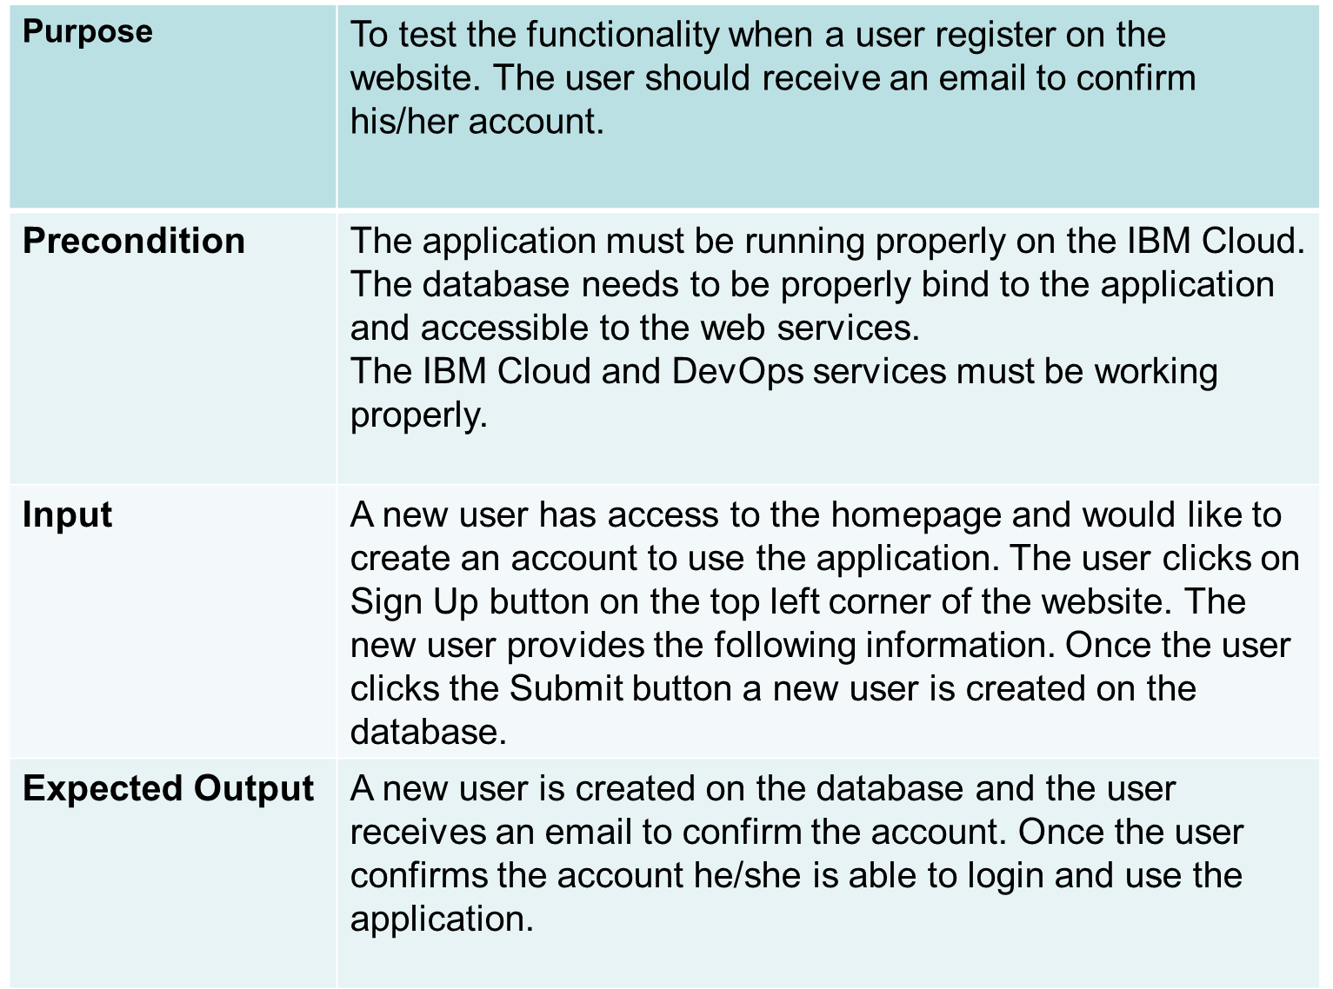
Sunny Day

Slide 12
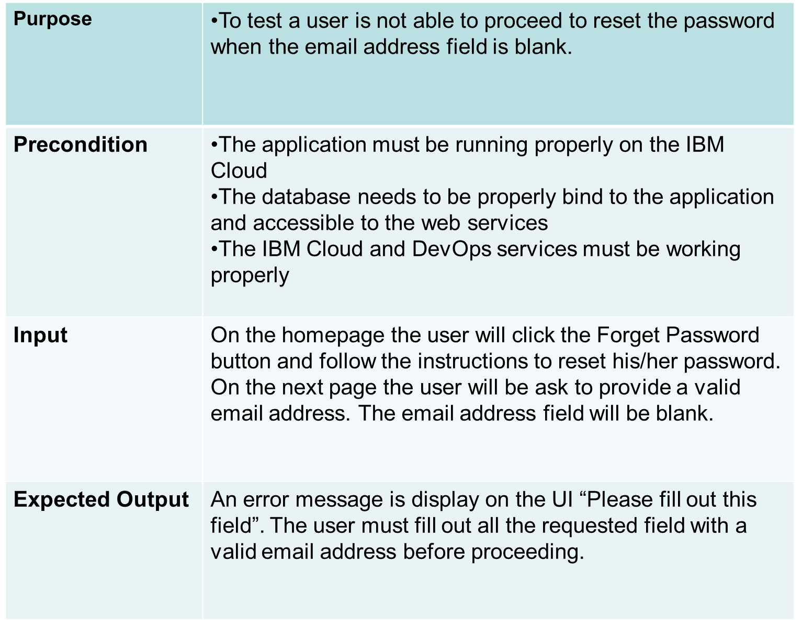
Rainy Day
Notes:
7. Test Suites and Test Cases (one sunny day and one rainy day) for the use case represented in part (5) above (2 slides).
7.1 One sunny day and one rainy day for the implemented use cases (one or more slides).
7.2 Automated test scripts for the implemented use cases (one or more slides).

Slide 13
Thank You
Although the Q&A engine is not fully implemented, most user stories were implemented such as create account, user login, verify account.
contact information: mchiu002@fiu.edu
Questions?
Thank You!
Notes:
Summarize your contribution
Include your contact information
Ask if anyone has any questions for you.
Thank your audience

